Slide 1
Road Traffic Dataset Aarhus Denmark DS-670
Kapil Bastola
Competitor Article Presentation

Slide 2
Content
Introduction
Data Set Introduction and Data Processing
Competitor Article
Background
Methods
Experimental Set-up
Results
Limitations
How to make it better
Data Visualizations
Conclusion

Slide 3
Data Set Introduction and Data Processing
This dataset consists of data from traffic in a city called Aarhus in Denmark. This dataset is collection of traffic data between two points for certain duration of time in CSV format for different durations. A CSV metadata file is also available that provides additional information regarding the different two points.

Slide 4
Data Set Introduction and Data Processing
Among the different duration of data set present in the website, I picked dataset 1 which is from Feb 2014 to June 2014
The downloaded dataset zip file had 449 CSV files in total.
I used zeppelin to bring these files together for further analysis

Slide 5
Data Set Introduction and Data Processing
Upon further analysis it was found that the dataset has 9 columns. These are:
status,
avgMeasuredTime,
avgSpeed,
extID,
medianMeasuredTime,
TIMESTAMP,
vehicleCount,
_id, and
REPORT_ID.

Slide 6
Data Set Introduction and Data Processing
For further data analysis I combined all the files in the directory mentioned above into one table called “roadtraffic” using Spark
I registered the table as an SQL table and ran queries to see what the dataset looks like and obtain data summary.

Slide 7
Competitor Article
The article I am going to make better is:
Short-Term Trafﬁc Flow Forecasting: An Experimental Comparison of Time-Series Analysis and Supervised Learning
Reference
Lippi, M., Bertini, M., & Frasconi, P. (2013). Short-Term Traffic Flow Forecasting: An Experimental Comparison of Time-Series Analysis and Supervised Learning. IEEE Transactions on Intelligent Transportation Systems, 14(2), 871-882. doi:10.1109/tits.2013.2247040

Slide 8
Background
The literature on short-term trafﬁc ﬂow forecasting has undergone great development recently.
Many works, describing a wide variety of different approaches, which very often share similar features and ideas, have been published.
However, publications presenting new prediction algorithms usually employ different settings, data sets, and performance measurements, making it difﬁcult to infer a clear picture of the advantages and limitations of each model.

Slide 9
Method
The authors first reviewed existing approaches to traffic flow forecasting the common view of probabilistic graphical models, presenting an extensive experimental comparison, which proposes a common baseline for their performance analysis and provides the infrastructure to operate on a publicly available data set.
Then the authors provide two new support vector regression models, which are speciﬁcally devised to beneﬁt from typical trafﬁc ﬂow seasonality and are shown to represent an interesting compromise between prediction accuracy and computational efﬁciency.

Slide 10
Experimental Set-up
The set of tested competitors consists of the following algorithms:
1) RW, which is a simple baseline that predicts trafﬁc in the future as equal to current conditions
2) SM, which predicts for a given time of the day the average in the training set;
3) ARIMA model with Kalman ﬁlter
4) SARIMA model with maximum-likelihood ﬁtting
5) SARIMA model with Kalman ﬁlter
6) ANNs
7) Support Vector Regressor (SVR) with RBF kernel
8) SVR with RBF kernel multiplied by a seasonal kernel
9) SVR with linear seasonal kernel

Slide 11
Results
The authors found that the Seasonal ARIMA (SARIMA) model coupled with a Kalman ﬁlter is the most accurate model;
However, when forecasting during the most congested periods the seasonal support vector regressor (SVR) was found to be highly competitive method as well

Slide 12
Limitations
This study only looks at short-term traffic flow
There are some algorithms that this study does not look at

Slide 13
How to make it better
Look into predicting long-term traffic flow as well as short term traffic flow
Incorporate methods of predicting traffic flow other than ones used in the paper

Slide 14
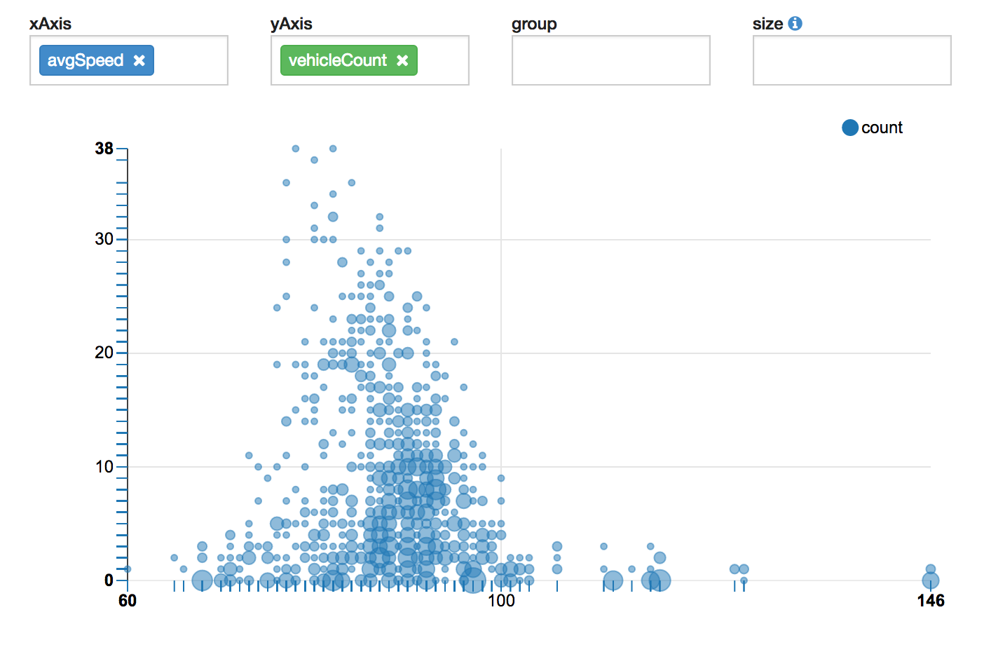
Data Visualization Scatter Plot of Average Speed vs. Vehicle Count

Slide 15
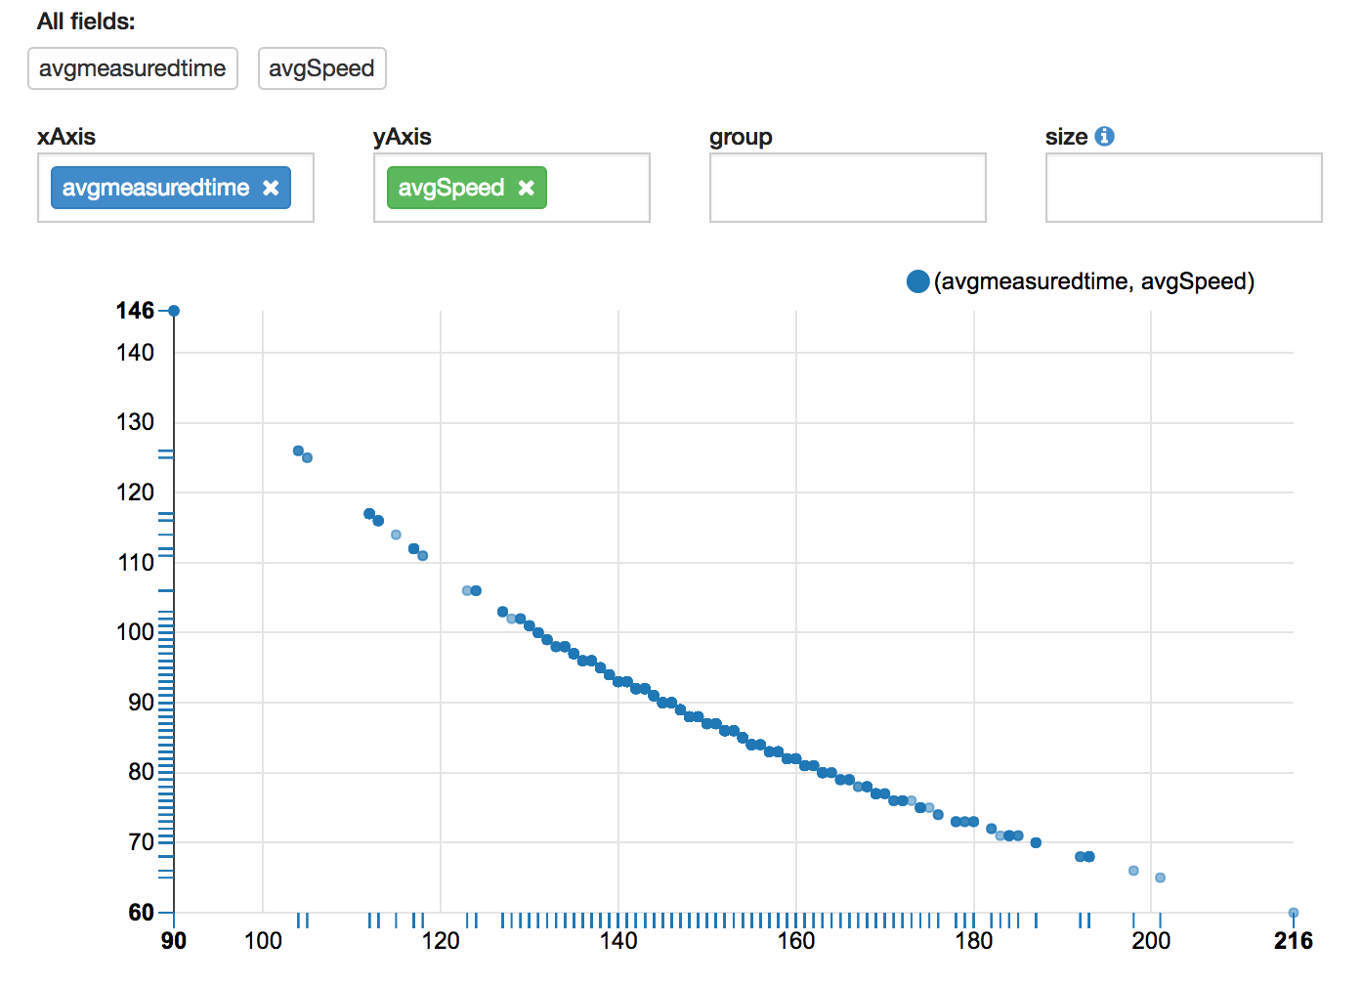
Data Visualization Scatter Plot of Average Speed and Average Measured Time

Slide 16
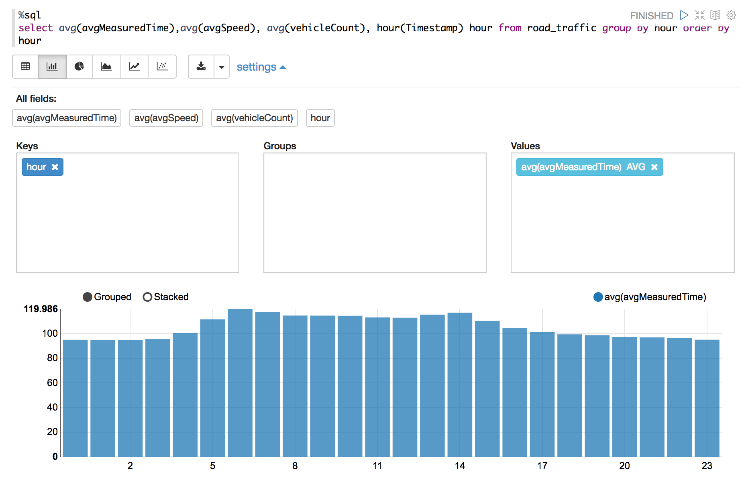
Data Visualization Bar chart of average measured time grouped by hour of day

Slide 17
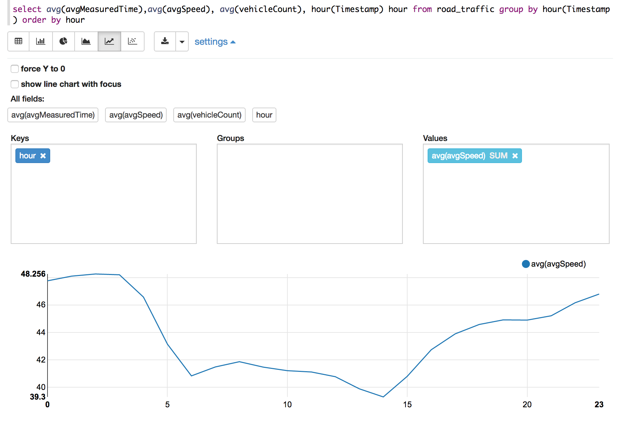
Data Visualization Average speed by hour of day

Slide 18
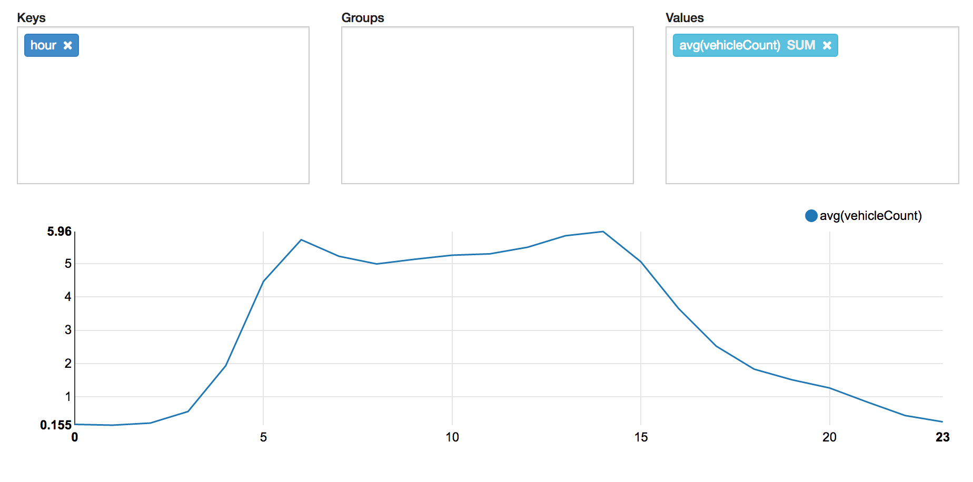
Data Visualization Average vehicle count by hour of day

Slide 19
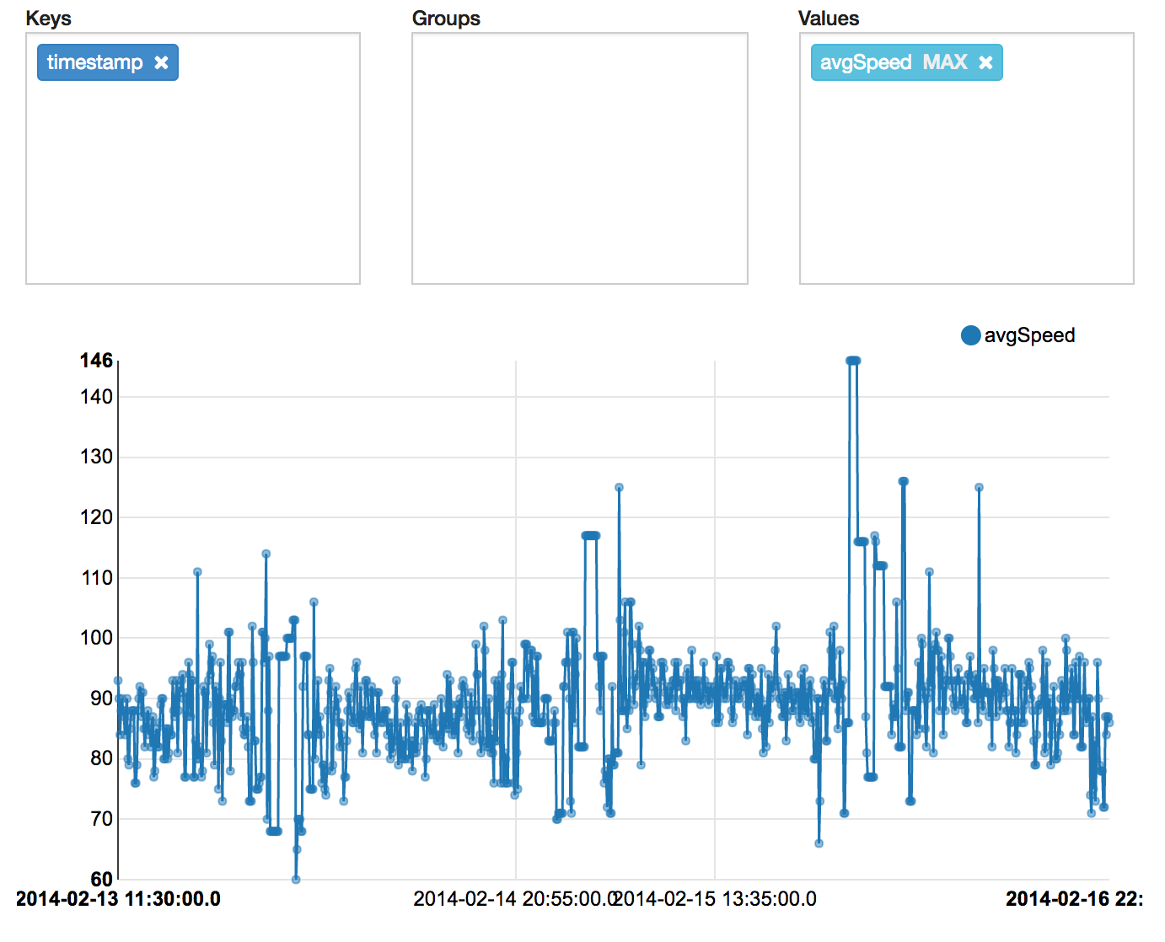
Data Visualization Time series of average speed

Slide 20
Conclusion
Since I have a time-series data I chose to look at research paper that focuses on time series methodologies like ARIMA and SARIMA
I believe we can expand on what is done in the paper in terms of looking at long-term prediction as well as looking into other methods of predicting traffic flow
I used Spark and SQL in Zeppelin for creating data visualizations

